Slide 1
Information Systems,
Chapter 1
An Introduction to Information Systems

Slide 2
Principles and Learning Objectives
The value of information is directly linked to how it helps decision makers achieve the organization’s goals
  Discuss why it is important to study and understand information systems
  Distinguish data from information and describe the characteristics used to evaluate the value of data
Information Systems, Tenth Edition

Slide 3
Principles and Learning Objectives (continued)
Computers and information systems help make it possible for organizations to improve the way they conduct business
  Name the components of an information system and describe several system characteristics
Information Systems, Tenth Edition

Slide 4
Principles and Learning Objectives (continued)
Knowing the potential impact of information systems and having the ability to put this knowledge to work can result in a successful personal career and in organizations that reach their goals
  List the components of a computer-based information system
  Identify the basic types of business information systems and discuss who uses them, how they are used, and what kinds of benefits they deliver
Information Systems, Tenth Edition

Slide 5
Principles and Learning Objectives (continued)
System users, business managers, and information systems professionals must work together to build a successful information system
  Identify the major steps of the systems development process and state the goal of each
Information Systems, Tenth Edition

Slide 6
Principles and Learning Objectives (continued)
Information systems must be applied thoughtfully and carefully so that society, businesses, and industries can reap their enormous benefits
  Describe some of the threats that information systems and the Internet can pose to security and privacy
  Discuss the expanding role and benefits of information systems in business and industry
Information Systems, Tenth Edition

Slide 7
Why Learn About Information Systems?
Information systems used by:
  Sales representatives
  Managers
  Financial advisors
  Others
Information Systems, Tenth Edition

Slide 8
Introduction
Information system (IS):
  A set of interrelated components that collect, manipulate, and disseminate data and information and provide feedback to meet an objective
Used by :
  Businesses, organizations and government
Information Systems, Tenth Edition

Slide 9
Information Concepts
Information:
  One of an organization’s most valuable resources
  Often confused with the term data
Differentiate: data, information and knowledge
Information Systems, Tenth Edition

Slide 10
The Characteristics of Valuable Information
What happen if an organization’s information is not accurate or complete:
Why valuable information is important:
  Can help people and their organizations perform tasks more efficiently and effectively
Information Systems, Tenth Edition

Slide 11
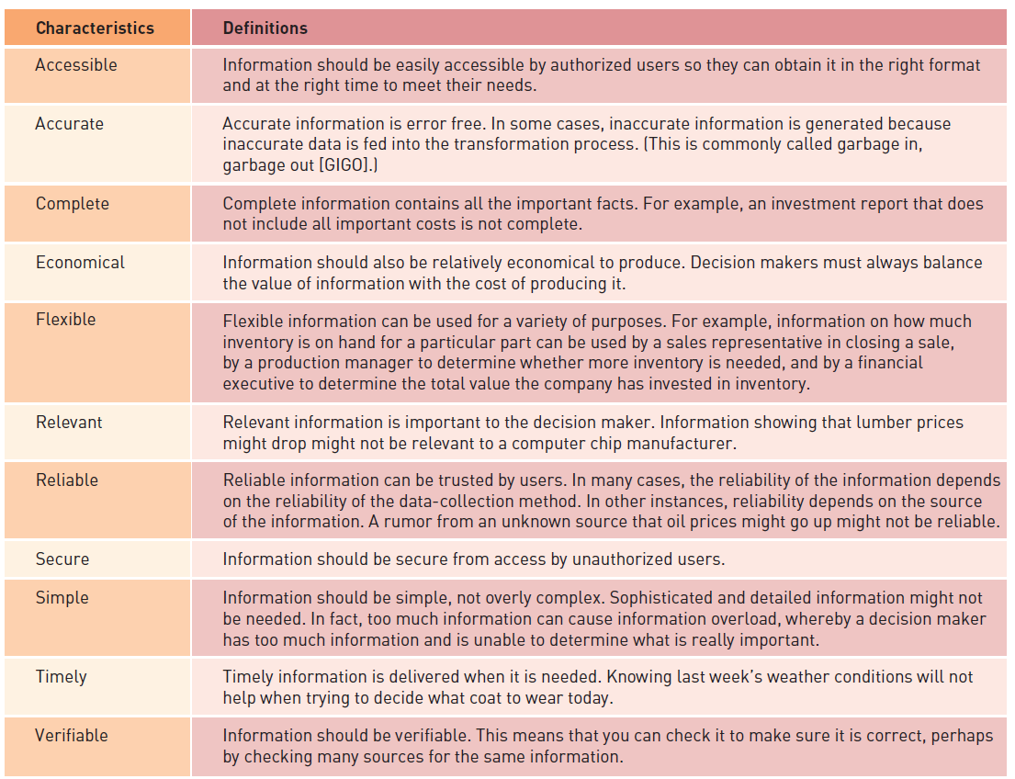
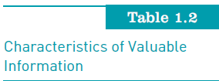
The Characteristics of Valuable Information (continued)
Information Systems, Tenth Edition

Slide 12
System Concepts
System:
  Set of elements or components that interact to accomplish goals
4 Components of a system: ??
Information Systems, Tenth Edition

Slide 13
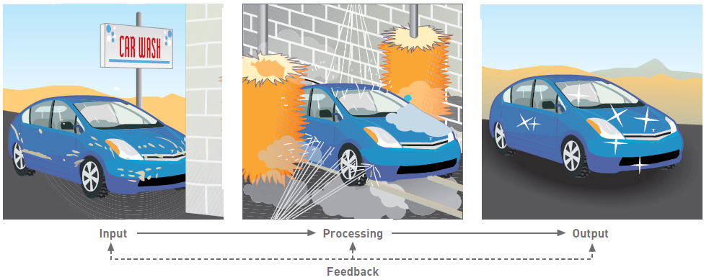
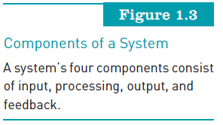
System Concepts (continued)
Information Systems, Tenth Edition

Slide 14
System Performance and Standards
Evaluated by:
Efficiency vs Effectiveness:
System performance standard:
  Specific objective of the system
Information Systems, Tenth Edition

Slide 15
What is an Information System?
Information system (IS) is a set of interrelated elements that:
  Collect (input)
  Manipulate (process)
  Store
  Disseminate (output) data and information
  Provide a corrective reaction (feedback mechanism) to meet an objective
Information Systems, Tenth Edition

Slide 16
Manual and Computerized Information Systems
An information system can be:
  Manual or computerized
Manual Information System: example ??
Computerized information systems: example ??
Information Systems, Tenth Edition

Slide 17
Computer-Based Information Systems
6 components: ??
  That are configured to collect, manipulate, store, and process data into information
Inter-related each other
Information Systems, Tenth Edition

Slide 18
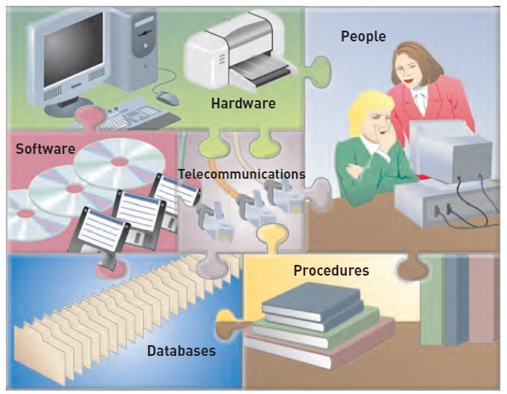
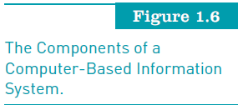
Computer-Based Information Systems (continued)
Information Systems, Tenth Edition

Slide 19
Business Information Systems
What are the most common types of information systems:
  Those designed for electronic and mobile commerce, transaction processing, management information, and decision support
Information Systems, Tenth Edition

Slide 20
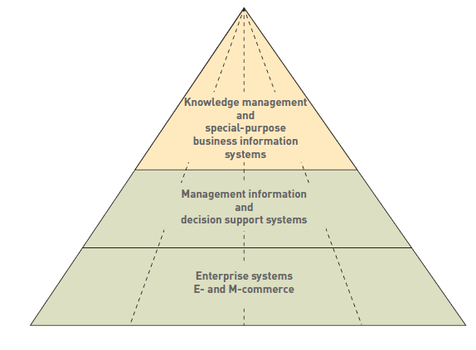
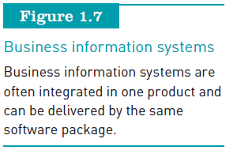
Business Information Systems (continued)
Information Systems, Tenth Edition

Slide 21
Electronic and Mobile Commerce
E-commerce:
  Any business transaction executed electronically between:
    Companies (business-to-business, B2B)
    Companies and consumers (business-to-consumer, B2C)
    Consumers and other consumers (consumer-to-consumer, C2C)
    Business and the public sector
    Consumers and the public sector
Information Systems, Tenth Edition

Slide 22
Electronic and Mobile Commerce (continued)
Mobile commerce (m-commerce):
  The use of mobile, wireless devices to place orders and conduct business
Electronic business (e-business):
  Uses information systems and the Internet to perform all business-related tasks and functions
Information Systems, Tenth Edition

Slide 23
Enterprise Systems: Transaction Processing Systems
Transaction
  Any business-related exchange, such as payments to employees and sales to customers
Transaction processing system (TPS):
  Organized collection of people, procedures, software, databases, and devices used to record completed business transactions
Information Systems, Tenth Edition

Slide 24
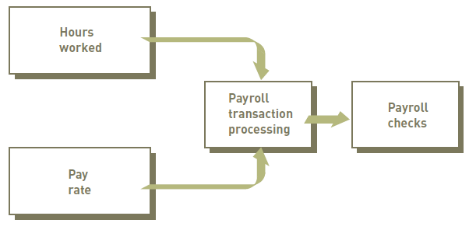
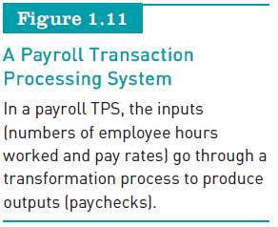
Enterprise Systems: Transaction Processing Systems
Information Systems, Tenth Edition

Slide 25
Information and Decision Support Systems
Management information system (MIS):
  Organized collection of people, procedures, software, databases, and devices that:
    Provides routine information to managers and decision makers
Information Systems, Tenth Edition

Slide 26
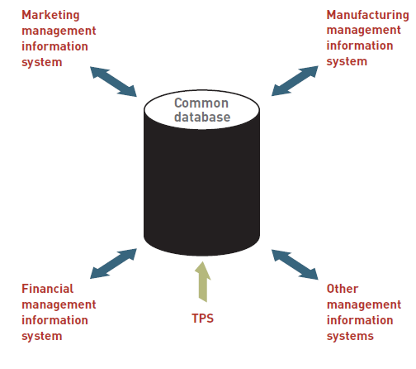
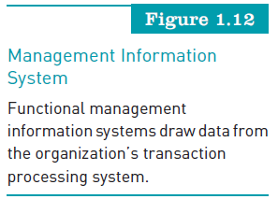
Information and Decision Support Systems (continued)
Information Systems, Tenth Edition

Slide 27
Information and Decision Support Systems (continued)
Decision support system (DSS):
  Organized collection of people, procedures, software, databases, and devices that support problem-specific decision making
  Used when problem is complex and information needed to determine appropriate action is difficult to obtain
Information Systems, Tenth Edition

Slide 28
Specialized Business Information Systems: Knowledge Management, Artificial Intelligence, Expert Systems, and Virtual Reality
Knowledge management systems (KMSs):
  Organized collection of people, procedures, software, databases, and devices
Artificial intelligence (AI):
  Computer system takes on characteristics of human intelligence
Information Systems, Tenth Edition

Slide 29
Specialized Business Information Systems (continued)
Expert systems:
  Give computer ability to make suggestions and function like an expert in a particular field
Virtual reality:
  Simulation of a real or imagined environment that can be experienced visually in three dimensions
Information Systems, Tenth Edition

Slide 30
Systems Development
Systems development:
  The activity of creating or modifying existing business systems
Outsourcing vs InHouse development
Information Systems, Tenth Edition

Slide 31
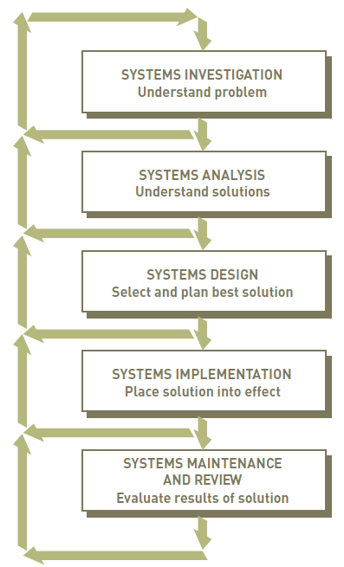
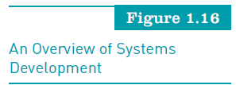
Systems Development (continued)
Information Systems, Tenth Edition

Slide 32
Information Systems in Society, Business, and Industry
Information systems:
  Widely used, Important to every organization
  Have been developed to meet the needs of all types of organizations and people
  Speed and widespread use opens users to a variety of threats from unethical people
Information Systems, Tenth Edition

Slide 33
Security, Privacy, and Ethical Issues in Information Systems and the Internet
Drawbacks of information systems:
Need to protect against threats to your privacy and data. How??
Use of information systems:
  Raises work concerns, including job loss through increased efficiency
Information Systems, Tenth Edition

Slide 34
Information Systems in the Functional
Areas of Business
Functional areas and operating divisions of business and industries
  Finance and accounting
  Sales and marketing
  Manufacturing
  Human resource management
  Legal information systems
Information Systems, Tenth Edition

Slide 35
Information Systems in Industry
Industries:
  Airline industry : AirAsia.com, MalaysiaAIrlines.com
  Investment firms : eagle management system
  Banks : cimbclicks.com, maybank2u.com
  Transportation industry : MT Transportation, DHL
  Publishing companies : thestar.com. MPH Online
Information Systems, Tenth Edition

Slide 36
Information Systems in Industry (continued)
Industries (continued):
  Healthcare : E-Health
  Retail companies : Online shopping mall
  Many others such as power management and utility companies, professional services and management consulting firms
Information Systems, Tenth Edition

Slide 37
Global Challenges in Information Systems
Cultural challenges
Language challenges
Time and distance challenges
Infrastructure challenges
Currency challenges
Information Systems, Tenth Edition

Slide 38
Global Challenges in Information Systems (continued)
Product and service challenges
Technology transfer issues
State, regional, and national laws
Trade agreements
Information Systems, Tenth Edition

Slide 39
Summary
Differentiate data, information, information system
IS Components
Components of CBIS
Types of information system such as E-commerce, TPS, DSS, etc.
System development
Computer and information systems literacy

